Slide 1
PATTERN CLASSIFICATION

Slide 2
MACHINE PERCEPTION
Building a machine that can recognize patterns
Speech recognition
Fingerprint identification
Optical Character recognition(OCR)
DNA sequence identification

Slide 3
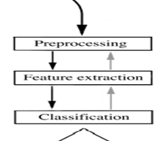

Slide 4
EXAMPLE
“Sorting incoming Fish on a conveyor according to species using optical sensing”
Sea bass
Species
Salmon
Set up a camera and take some sample images to extract features
Length
Lightness
Width
Number and shape of fins
Position of the mouth
Eg. of set of all suggested features to explore for use by the classifier!

Slide 5
PREPROCESSING and SEGMENTATION
NEED
Simplify subsequent operation without losing relevant information ( Eg. Adjust average light level or threshold, remove background,…
Isolation of different features
Feature Extractor
Reduces data by measuring certain features / properties
Sends information to classifier

Slide 6
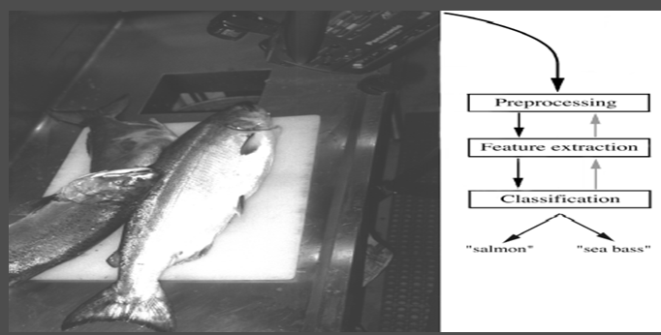

Slide 7
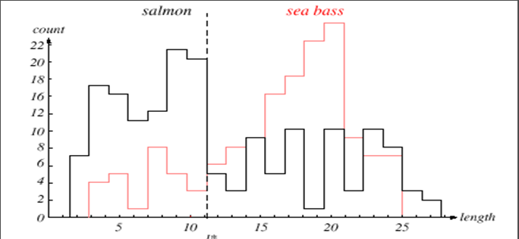
E.g. Length of Fish as Discriminator

Slide 8
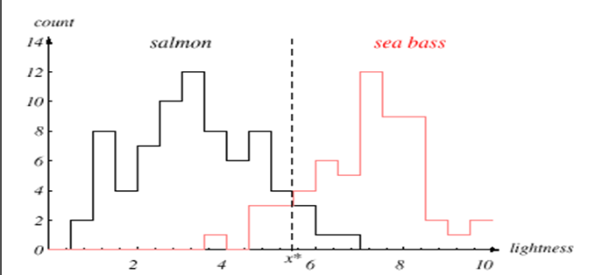
E.g. Lightness of Fish as Discriminator

Slide 9
DECISION THEORY
Find value of l* that leads to smallest number of errors
Threshold decision boundary and cost relationship ( Eg. Of problem where A classified as B is more disagreeable than B classified as A ) Gold / Diamond
Move our decision boundary toward smaller values of lightness in order to minimize the cost (reduce the number of sea bass that are classified salmon!)
Task of decision theory
Overall error in data lower if 2 features considered instead of one

Slide 10
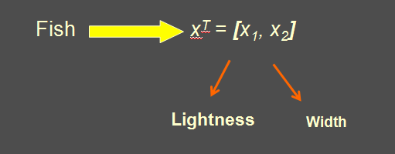
EXAMPLE – CONTD.
Adopt lightness as a feature and add width of the fish ( Feature Vector )

Slide 11
CHARACTERISTICS
Increasing the number of features lead to better classification but
Some features may be redundant
Some features are too expensive / provide very little improvement / even degrade performance
If models – extremely complicated, decision boundary – more complex than a straight line
Disadvantage – Complex line may not provide accurate solution but may be tuned to particular training samples

Slide 12
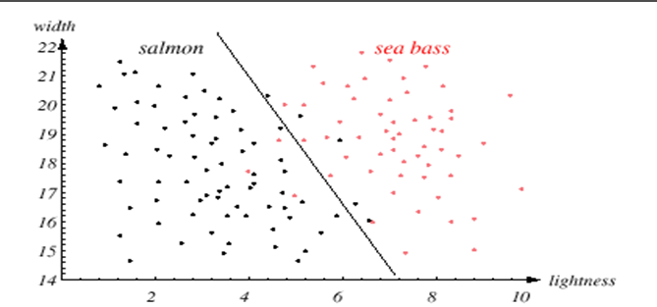
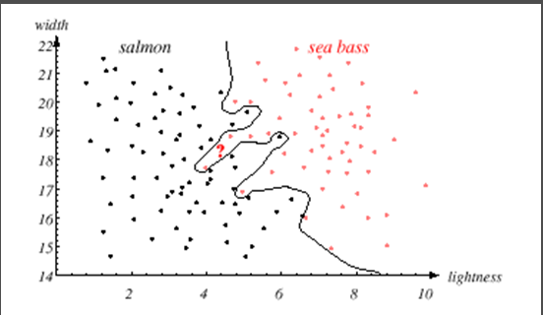

Slide 13
SOLUTIONS
One solution – Provide more training samples ( But not possible in some applications )
Alternate solution – Generalization - Satisfied with slightly poor performance on training samples if it means classifier has a better performance on novel patterns
Decisions are fundamentally cost / task specific
Challenge – Designing a single device capable of acting accurately based on a wide variety of tasks.

Slide 14
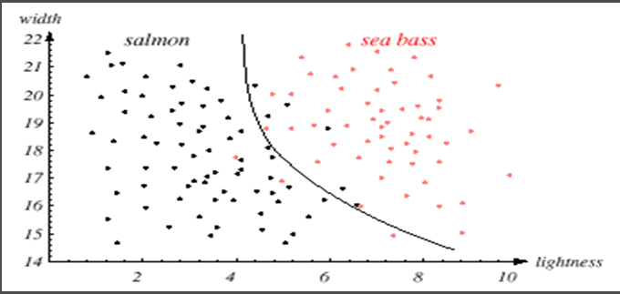
TRADEOFF BETWEEN PERFORMANCE AND SIMPLICITY OF THE CLASSIFIER

Slide 15
Aim : Correctly categorize novel input
Concepts
Decision Theory
Decision Rule
Decision boundary
Generalization

Slide 16
STATISTICAL PATTERN RECOGNITION
SYNTACTIC NEURAL
Representation that needs proper classification
Speed of classification
Patterns that lead to same action – close to one another
In cases where there exist insufficient training data, incorporate knowledge of the problem domain

Slide 17
ANALYSIS BY SYNTHESIS
Examples
NLP ( Eg pronounced )
Production representation
For chair
Functionality
OCR
Handwritten characters as a sequence of strokes
In pattern classification, sensed data – decides whether to reject null hypothesis in favour of an alternate hypothesis

Slide 18
CONCEPTS
Associative Memory
Information loss as number of features chosen lesser than total necessary
Regression
Predict new input with functional description of data
E.g. Linear – Weight of salmon varies linearly with age
Interpolation
Density Estimation
Probability of estimating the density ( probability ) that a member of a certain category will be found to have particular features
Mereology
Problem of subsets and supersets – study of part / whole relationships
Overfitting
Complex system may allow perfect classification of training samples but unlikely to perform well on new patterns

Slide 19
PATTERN RECOGNITION SYSTEMS
Sensing
Use of a transducer (camera or microphone)
PR system depends of the bandwidth, the resolution sensitivity distortion of the transducer
Segmentation and grouping
Patterns should be well separated and should not overlap

Slide 20
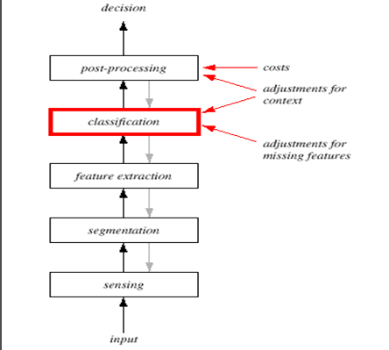
STEPS

Slide 21
STEPS
Feature extraction
Discriminative features
More problem and domain dependent
Selection of most valuable feature from larger set of candidate features
Invariant features with respect to translation, rotation and scale.
Occlusion
Part of image hidden behind another part
Projective Distortion
Change in distance between object and image
Rate Variation
Example – Speed of talking and information generated
Deformation
Example – Intensity of light change, holding / pressing an object – Explanation…

Slide 22
STEPS ( Contd. )
Classification
Use a feature vector provided by a feature extractor to assign the object to a category
Role of Noise
Post Processing
Exploit context input dependent information other than from the target pattern itself to improve performance ( Example \n etc. )
Error Rate ( Concept of False Positives and Negatives )
Minimization of Total expected cost ( Risk )
Multiple Classifiers

Slide 23
DESIGN CYCLE
Data collection
Feature Choice
Model Choice
Training
Evaluation
Computational Complexity

Slide 24
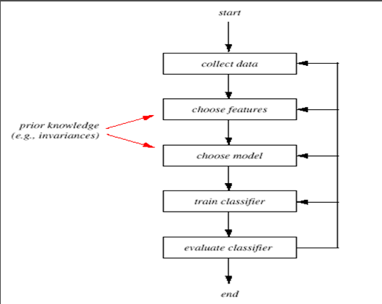
DESIGN CYCLE

Slide 25
DESIGN CYCLE
Data Collection
How do we know when we have collected an adequately large and representative set of examples for training and testing the system?
Feature Choice
Depends on the characteristics of the problem domain. Simple to extract, invariant to irrelevant transformation insensitive to noise.
Aspects of incorporating prior knowledge
Model Choice
Unsatisfied with the performance of our fish classifier and want to jump to another class of model

Slide 26
DESIGN CYCLE ( Contd. )
Training
Use data to determine the classifier. Many different procedures for training classifiers and choosing models
Evaluation
Measure the error rate (or performance and switch from one set of features to another one
Overfitting : Perfect classification of training samples but unable to perform well on new patterns.
Computational Complexity
What is the trade-off between computational ease and performance?
(How an algorithm scales as a function of the number of features, patterns or categories?)

Slide 27
LEARNING TYPES
SUPERVISED LEARNING
Teacher provides category label / cost for each pattern in training set
Aspects to be considered : learning algorithm – powerful/ convergence in limited time / no of input features / categories
UNSUPERVISED LEARNING
System forms clusters / natural groupings
Avoiding inappropriate representations
REINFORCEMENT LEARNING
Reward based Learning
Role of critic

